Slide 1
Credit Card Fraud Detection
Group 2: Dov

Slide 2
Project Objective
Use different models to recognize the credit card fraud case
By using hyperparameter tuning, feature engineering and ensemble technique to optimize the model
Precision: False positive 🡨 Save operation cost
Recall: False negative 🡨 Help customers, also save cost

Slide 3
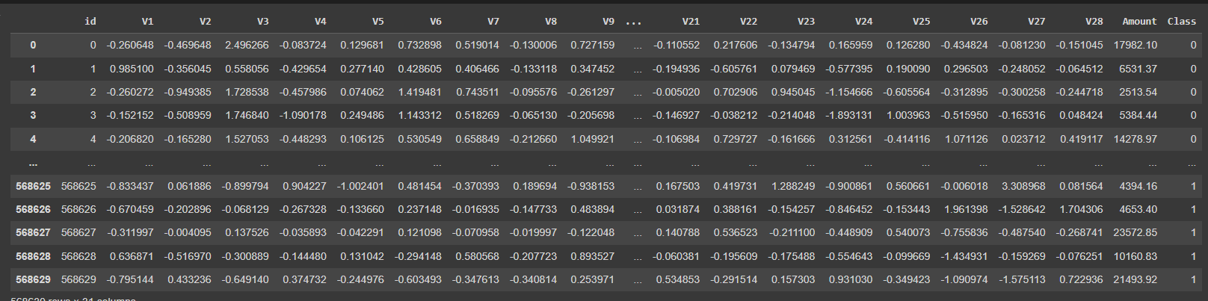
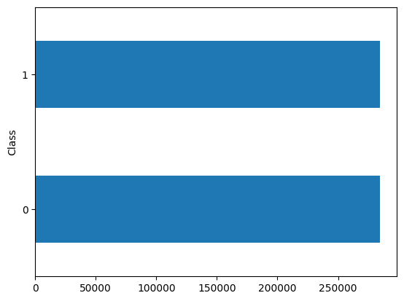
Data description
0 = Normal Case
1 = Fraud Case
Resampling is not required

Slide 4
Data Preprocessing
V1 – v28: We don’t know what are them -> no action needed except standardization
Data cleansing: no null or duplicated cases
Drop ‘id’
Split Data into X and y.
Split Data into train data (80%) and test data (20%)

Slide 5
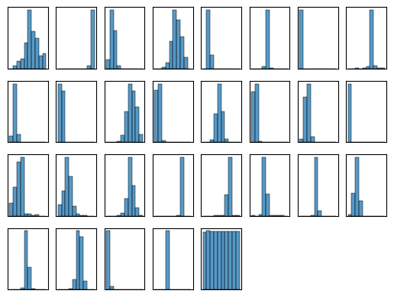
EDA

Slide 6

Model Selections (Classification)
Logistic Regression
K Nearest Neighbors (KNN)
SVM (Support Vector Machine)
Random Forest
Naive Bayes Classifiers (Supposed)
Voting Ensemble (Supposed)

Slide 7
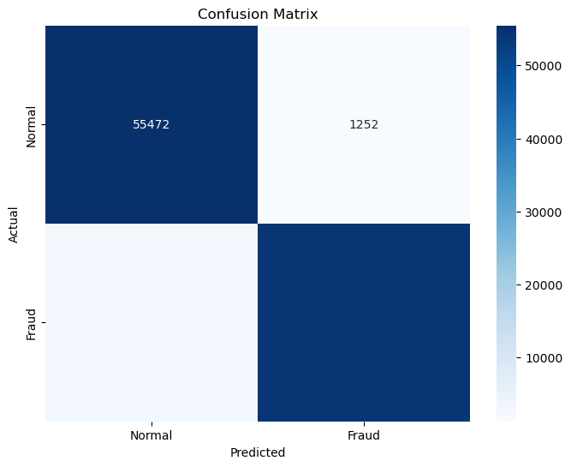
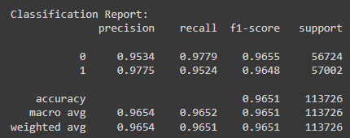
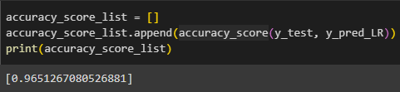
Logistic Regression
2714
54288

Slide 8
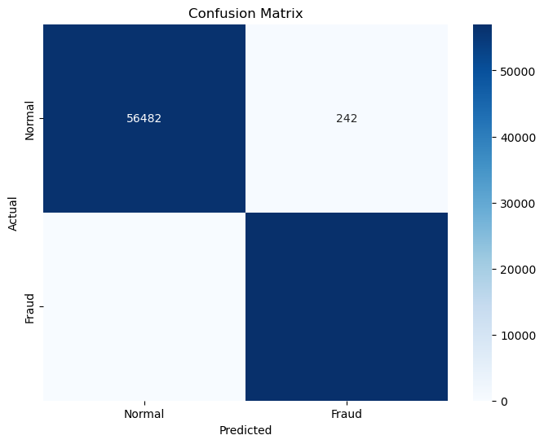
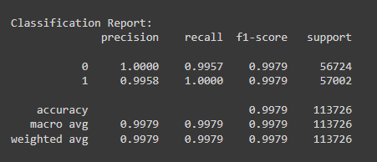

KNN
0
57002

Slide 9

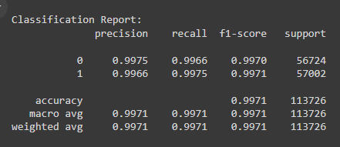
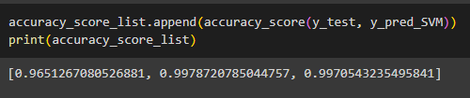
SVM
141
56861

Slide 10

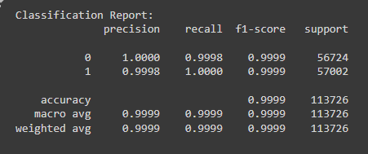

Random Forest
Overfit?
0
57002

Slide 11
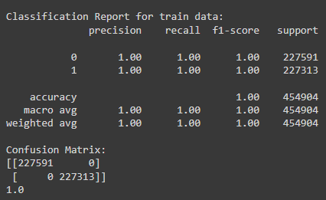
Comparison with train data

Slide 12
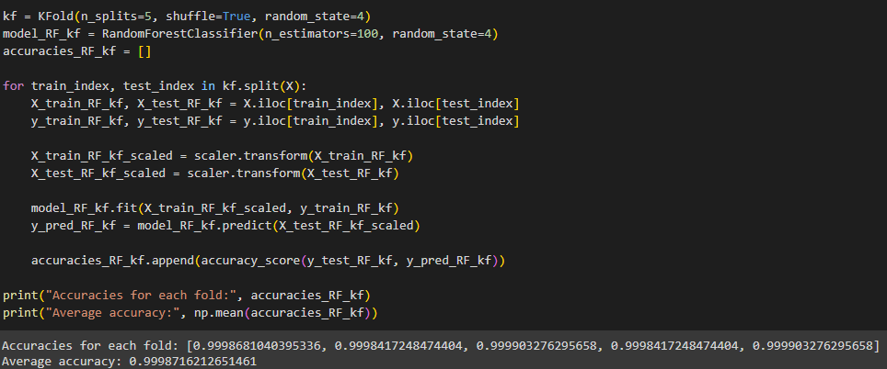
K-Fold Cross-Validation

Slide 13
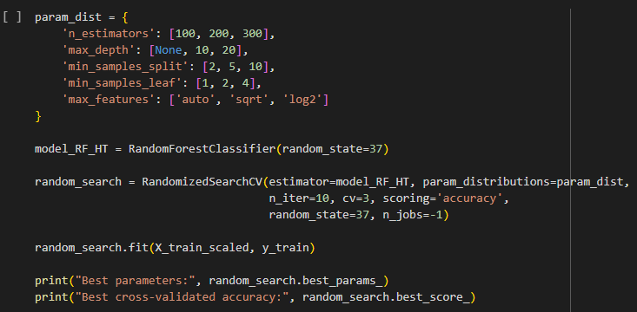
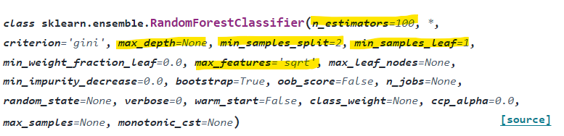
Hyperparameter Tuning

Slide 14
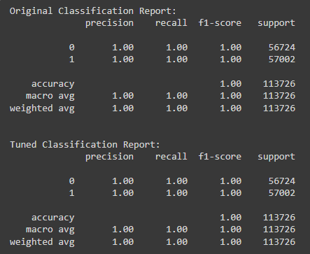
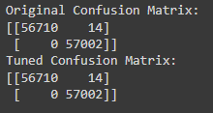
Hyperparameter Tuning

Slide 15
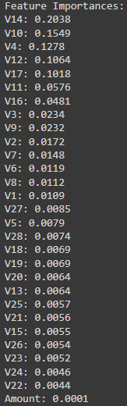
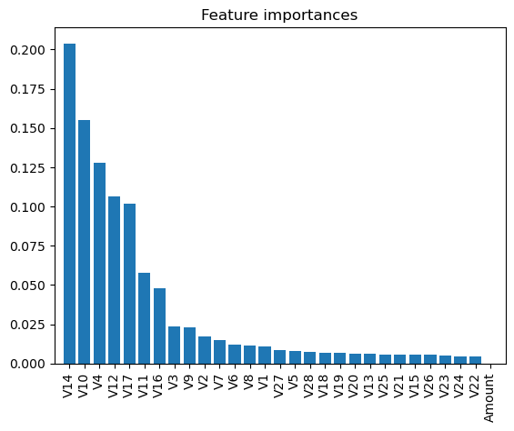
Feature Importance

Slide 16
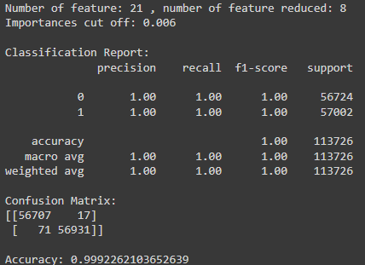
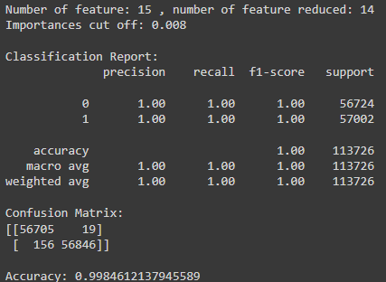
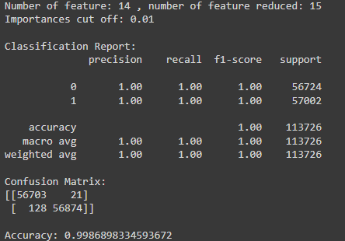
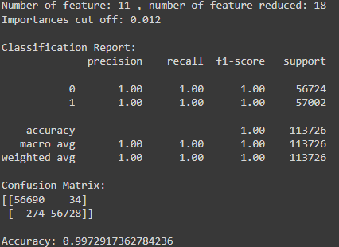
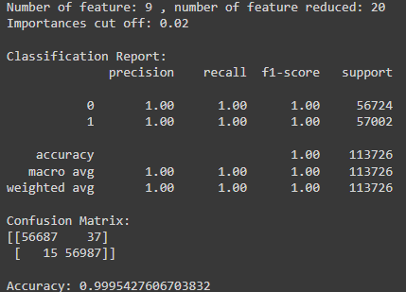
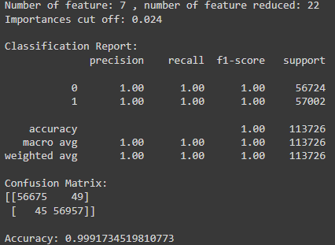
Feature Selection

Slide 17
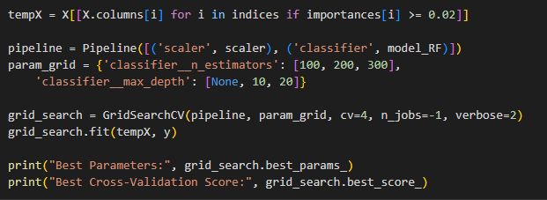
Final K Fold & Hyperparameter Tuning

Slide 18
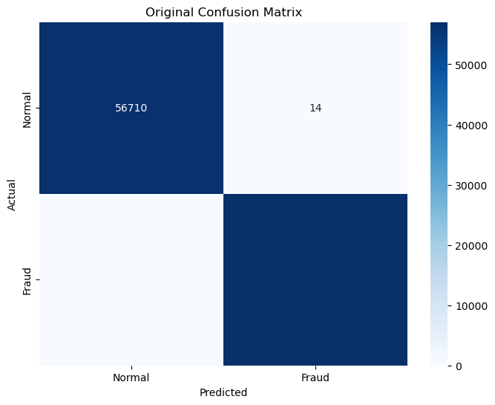

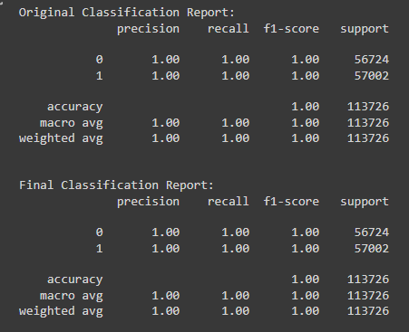

Comparison with original model
0
57002
13
56989

Slide 19
Comparison with original model
 | Number of features | % change | Accuracy | % change | False Positive | % in Total | False Negative | % in Total
Original Model | 29 |  | 0.999877 |  | 14 | 0.02% | 0 | 0
Final Model | 9 | -69% | 0.999604 | -0.03% | 32 | 0.06% | 13 | 0.02%

Slide 20
Challenges and Limitations
Challenges:
Selection of Model, hyperparameter tuning & feature engineering
Overfitting
Limitations:
Unknown meaning of feature (v1 – v28) 🡪 cannot do further feature engineering
Data source limitation: from European cardholders

Slide 21
Future Work
Try more models
Try ensemble technique
Test more hyperparameter
Try different combination of features
Use data from different countries

Slide 22
Conclusion
Random Forest > KNN > SVM > Logistic Regression
Conducted K Fold but still get high accuracy 🡪 Should be not overfitting
After feature selection, 20 features(69%) are removed and high accuracy(also precision & recall) is retained 🡪Save money
Amount is not important for Fraud detection (Maybe need to explore further)

Slide 23
Reference
https://scikit-learn.org/stable/modules/cross_validation.html
https://www.kaggle.com/code/willkoehrsen/intro-to-model-tuning-grid-and-random-search
https://www.kaggle.com/datasets/nelgiriyewithana/credit-card-fraud-detection-dataset-2023

